Slide 1
Chat More: Deepening and Widening the Chatting Topic via A Deep Model
姓名：周威信
日期：2018年5月24日

Slide 2
目录
1
研究背景
2
模型
3
实验数据
4
实验结果
5
结论

Slide 3
研究背景

Slide 4
1 Background
Dialog system:
1) Task-oriented: vertical domains
2) Non-task-oriented: open-domain topics
Implement methods:
1) Rule-based: restrict diversity
2) Retrieval-based: depend repository
3) Generation-based: more flexible
a) Single-turn: neglect historical conversation
b) Multi-turn
Notes:
The past decade has witnessed the boom of human-machine interactions, particularly via dialog systems.
Dialog systems have been widely used in a variety of applications, spanning from entertainment and knowledge sharing, to customer services.
Dialog systems can be divided into task-oriented and non-task-oriented categories. The former studies vertical domains. The latter studies open-domain topics.
Implement methods mainly includes rule-based, retrieval-based and generation-based methods.
To be more specific, the rule-based methods restrict diversity, the retrieval-based methods depend repository, the generation-based methods are more flexible.
The generation-based methods can divide into single-turn and multi-turn models.
Where, single-turn models neglect the context of conversation. Multi-turn generation-based methods are the best and the hardest.

Slide 5
2 Research Problem
Response generation in open-domain multi-turn dialog systems
Conversation example:
Person A: There is a heavy rain today.
Person B: The umbrella is totally useless.
Person A: The rain is really heavy. I got wet in the afternoon and caught a cold at night.
Person B: You should take some hot tea and get a good sleep.
Topic penetration
Topic extension
Notes:
In this paper, authors study the task of response generation in open-domain multi-turn dialog systems.
This shows the topic penetration.
This shows the topic extension.
The topic is deepened and widened.

Slide 6
3 Existing Research Defects
1) Without elaborated distinct, incorporates noises
2) No more attractive and meaningful
3) Dull response
Notes:
The first, the majority of prior eﬀorts consider all the phrases in the entire context without elaborated distinction, which indeed incorporates noises and may thus hurt the desired performance.
The second, Fewer researchers thus far have addressed the issue that making the conversation to be more attractive and meaningful.
The last, current generation-based systems frequently generate dull responses, which are not informative or meaningless. For example, I don’t know.

Slide 7
4 Challenges
1) How to identify the relevant words to eﬀectively guide the response generation?
2) How to avoid dull responses and generate responses that are not only relevant but also capable of deepening and widening the dialog topics?
3) How to construct a large-scale dataset for generation-based models?

Slide 8
5 Contributions
1) Separate the topic-related keywords from the irrelevant ones, avoid dull responses
2) Hybrid RNN and DNN model to deepen and widen the chatting topic firstly
3) Construct a dataset of multi-turn dialogs in the open domain and release the data, code and parameters

Slide 9
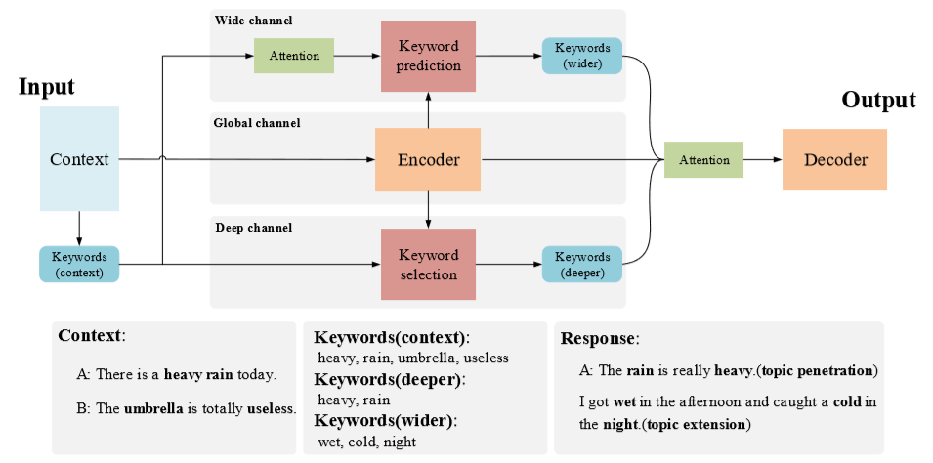
6 Model
Notes:
To deepen and widen the chatting topics, this paper present a scheme to explore the keywords in a dialog as shown in the picture. The scheme ﬁrst segments the utterances and extracts the keywords from the context. After that, the model inputs the context and its keywords into three parallel channels, namely, global, wide and deep channels. These channels respectively encode the context into an embedding vector, predict wider keywords, and select deeper keywords based on the context and its keywords. Ultimately, the model adopts an attention mechanism to weigh the context and keywords before feeding them into the RNN decoder that is used to generate a response.
Let’s detail each component of this scheme.

Slide 10
6.1 Keyword Extraction
Context:
A: There is a heavy rain today.
B: The umbrella is totally useless.
Context Keywords:
heavy, rain, umbrella, useless
Session
Word
Document
Term
TF-IDF
Notes:
This part, the authors apply TF-IDF to extract keywords from the context.
They removed the stop words and only retained nouns, verbs, and adjectives in corpus.
They consider a session as a document and a word as a term to calculate the TF-IDF value of each word.
They finally chose top 20 keywords from each session.

Slide 11
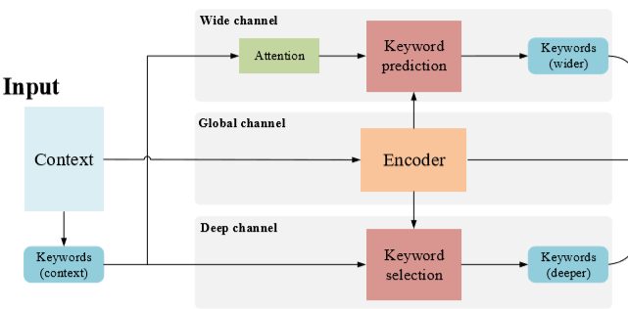

6.2 Global Channel
GRU: encode the given context into a vector
Notes:
In this channel, the authors apply a RNN equipped with GRU to encode the given context into a vector.
W is a sequence of tokens.
H is the hidden layer output.

Slide 12
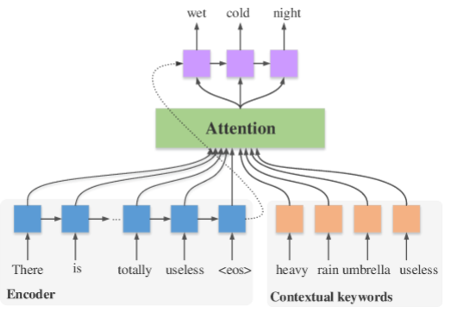
6.3 Wide Channel
Train an attention-based RNN model to predict keywords to extend topics
Notes:
In wide channel, authors train an attention-based RNN model to predict keywords to extend topics.

Slide 13
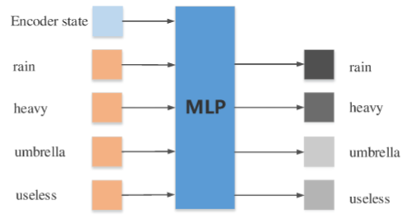
6.4 Deep Channel
Train an MLP to choose the useful keywords from the context
to deepen the topic of interest.
Notes:
The objective of the deep channel is to choose the useful keywords from the context to deepen the topic of interest.

Slide 14
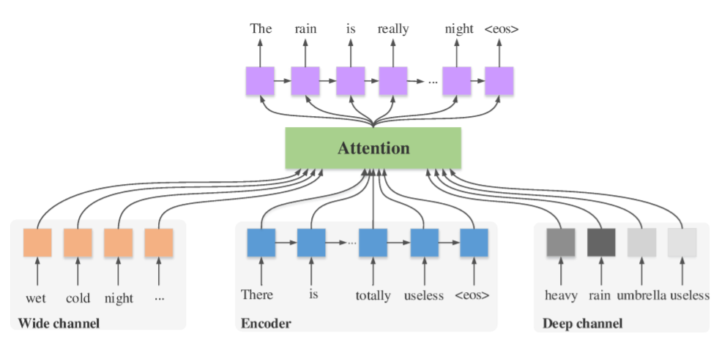
6.5 Decoder

Slide 15
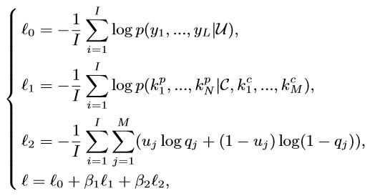
6.6 Loss Function

Slide 16
7.1 Dataset

Slide 17
7.2 Result

Slide 18
8 Innovations
1) Study the context-aware dialog systems
2) Deepen and widen the chatting topic

Slide 19
模型

Slide 20
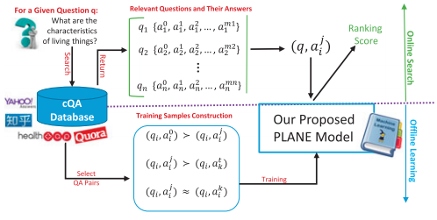
模 型

Slide 21
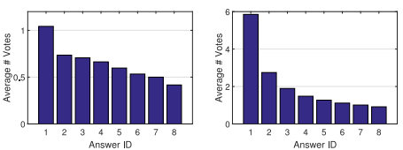
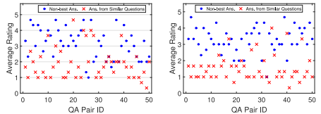
模 型——Offline Learning

Slide 22



模 型——Offline Learning
训练集
训练集

Slide 23


模 型——Offline Learning
目标函数：

Slide 24
模 型——Online Search
使用基于k-NN的聚类算法找到前k个相似的问题，通过收集所有与k个返回问题相关的答案构建答案候选池，将给定问题和答案候选池中的每个问题进行匹配

Slide 25
特征提取
Deep Features：采用Doc2Vec，提取的深度特征可以捕获单词的语义和顺序，能很好地表示QA对的上下文
Topic-Level Features：采用LDA进行QA表示，主题级的特征能够捕获低维度QA对的高级语义
Statistical Features：从QA对中独立提取特征，包括动词、名词、标签和停用词的数量，也提取了QA对之间重叠词的数量
User-Centric Features：为了验证用户的责任、意愿和信誉等，提取一组以用户为中心的特征，包括用户的个人简介长度、工作年限、追随者数量、受访者、收到的提问、收到的感谢等等

Slide 26
实验数据

Slide 27
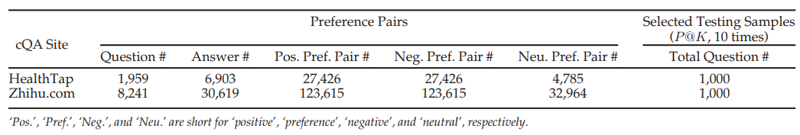
实验数据

Slide 28
实验结果

Slide 29
实验结果——对比方法
PointWise
Random Forests
Logistic Regression
PairWise
GBRank：gradient boosting rank
RankSVM
ListWise
AdaRank

Slide 30
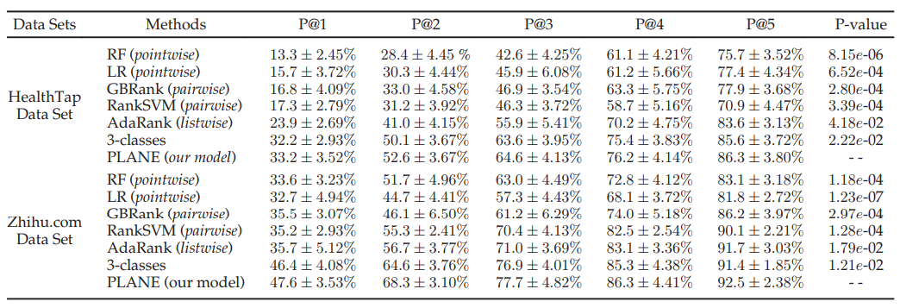
实验结果

Slide 31
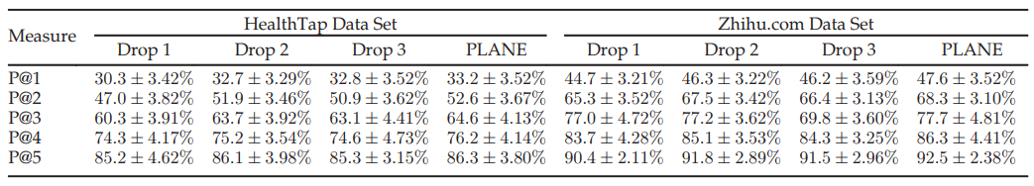
实验结果
Drop1：对于给定问题，没有考虑最佳和非最佳之间的偏好对
Drop2：对于给定问题，没有考虑非最佳答案之间的中性偏好
Drop3：对于给定问题，没有考虑其和其他问题的答案之间的偏好对

Slide 32
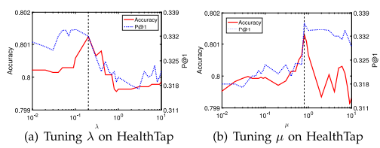
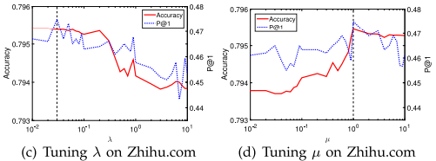
实验结果

Slide 33
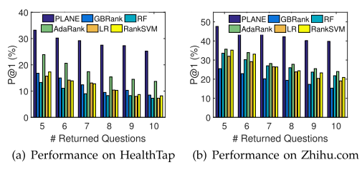
实验结果
随着k的增大，性能下降不是很大，进一步验证了该模型的鲁棒性

Slide 34
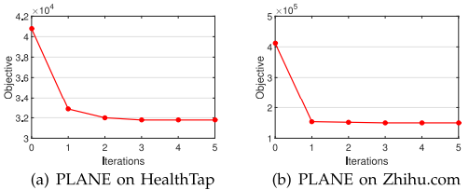
实验结果

Slide 35
结论

Slide 36
Contributions
提出一种新颖的方法构建positive、neural和negative偏好对作为训练样例，大大节省了耗时且费劳动力的标签处理
提出一个pairwise的学习模型为CQA系统中的答案选择排名，还融合了中性训练样例及学习可区别的特征

Slide 37
结 论
模型对参数变化不敏感
模型对扩大返回问题数量k带来的噪声影响是鲁棒的
pairwise模型包括论文中提到的PLANE模型对错误训练样本非常敏感
未来工作：解决pairwise模型中的固有缺点，包括对噪声敏感、大规模的偏序对、相关性判断中更细粒度信息的丢失

Slide 38
THANK YOU

